Slide 1
BITS Pilani
Dr. Lavika Goel
Assistant Professor
Department of CSIS
Pilani Campus

Slide 2
Concurrency
Pilani Campus

Slide 3
The Different Types of Concurrency
Concurrency in software execution can occur at four different levels:
  Instruction Level — executing two or more machine instructions simultaneously.
  Statement Level — executing two or more source language statements simultaneously.
  Unit Level — executing two or more subprogram units simultaneously.
  Program Level — executing two or more programs simultaneously.
E.g. web browser
Language designers view
Scalable
portable
Pilani Campus

Slide 4
The Different Types of Multi-processor Computers
The two most common categories of multi-processor computers are:
  Single-Instruction Multiple-Data (SIMD) —Computers that have multiple processors that execute the same instruction simultaneously, each on different data.
  Multiple-Instruction Multiple-Data (MIMD) —Computers that have multiple processors that operate independently but whose operations can be synchronized.
Pilani Campus

Slide 5
The Different Categories of Concurrency
There are two distinct categories of concurrent unit control:
  Physical Concurrency — Several program units from the same program literally execute concurrently on different processors.
  Logical Concurrency — Several program units from the same program are believed by the programmer and application software to execute concurrently on different processors. In fact, the actual execution of programs is taking place in an interleaved fashion on a single processor.
For the programmer and language designer points of view, both kinds of concurrency are the same.
Pilani Campus

Slide 6
Motivation for use of concurrency
Hardware capabilities provide concurrency
Faster execution
Different way of conceptualizing the problem
Applications distributed over machines require concurrency
Pilani Campus

Slide 7
Tasks
A Task or Process is a unit of a program, similar to a subprogram that can be in concurrent execution with other units of the same program.
There are three differences between tasks and subprograms:
  A task may be implicitly started while a subprogram must be explicitly called.
  When a program unit invokes a task, it need not wait for the task to be completed before continuing its own.
  When the execution of a task is completed, control may or may not return to the unit that started it.
Pilani Campus

Slide 8
(contd..)
Tasks fall into two categories:
  Heavyweight tasks — that execute in their own address space.
  Lightweight tasks — that all run in the same address space.
Lightweight tasks are easier to implement than heavyweight ones.
Tasks can typically communicate with other tasks in order to share the work necessary to complete the program.
Tasks that do not communicate with or affect the execution of other tasks are said to be disjoint.
Typically, though, tasks are not disjoint and must synchronize their execution, share data or both.
Pilani Campus

Slide 9
Synchronization
Synchronization is a mechanism that controls the order in which tasks execute. This can be done through cooperation or competition.
  Cooperation Synchronization is required between Tasks A and B when Task A must wait for Task B to complete some specific activity before Task A can continue its execution.
  Competition Synchronization is required between two tasks when both require the use of some resource that cannot be simultaneously used.
For cooperation synchronization specific tasks must be completed prior to a new task executing, whereas, for competition synchronization, specific resources should be free (independently of which task is using them) prior to a new task executing.
Pilani Campus

Slide 10
An example of Cooperation Synchronization
The Producer Consumer Problem
Program 1 produces data; Program 2 uses that data.
Synchronization is needed:
  The consumer unit must not take data if the buffer is empty
  The producer unit cannot place new data in the buffer if it is full
Storage Buffer
Program 1
(Producer)
Program 2
(Consumer)
Pilani Campus

Slide 11
Example of Competition Synchronization I
We have two tasks (A and B) and a shared variable (TOTAL)
Task A must add 1 to TOTAL
Task B must multiply TOTAL by 2.
Each task accomplishes its operation using the following process:
  Fetch the value of TOTAL
  Perform the arithmetic operation
  Put the new value back in TOTAL
TOTAL has an original value of 3.
Pilani Campus

Slide 12
Example of Competition Synchronization II
Without competition synchronization, 4 values could result from the execution of the two tasks:
  If A completes before B begins ➔ 8
  If A and B fetch TOTAL before either puts the new value back in, then we have:
    If A puts the new value back first ➔ 6
    If B puts the new value back first ➔ 4
  If B completes before A begins ➔ 7
This kind of situation is called a race condition because two or more tasks are racing to use the shared resources and the results depends on which one gets there first.
Pilani Campus

Slide 13
Design Issues for Concurrency:
Mechanisms for Synchronization
We will now discuss three methods of providing mutually exclusive access to resources:
  Semaphores
  Monitors
  Message Passing
In each case, we will discuss how the method can be used for Cooperation Synchronization and for Competition Synchronization.
Pilani Campus

Slide 14
Semaphores
A semaphore is a data structure consisting of an integer and a queue that stores task descriptors.
A task descriptor is a data structure that stores all of the relevant information about the execution state of a task.
The concept of a semaphore is that, to provide limited access to a data structure, guards are placed around the code that accesses the structure.
A guard allows the guarded code to be executed only when a specific condition is true. A guard can be used to allow only one task to access a shared data structure at a time.
A semaphore is an implementation of a guard. Requests for access to the data structure that cannot be honored are stored in the semaphore’s task descriptor queue until access can be granted.
There are two operations associated with a semaphore: wait and release.
Pilani Campus

Slide 15
Semaphores: Wait and release operations
Wait(Semaphore)
If Semaphore’s counter > 0 then
  Decrement Semaphore’s counter
else
  Put the caller in Semaphore’s queue
  Attempt to transfer control to
  some ready task
Release(Semaphore)
If Semaphore’s queue is empty (no task is waiting) then
  Increment Semaphore’s counter
Else
  Put the calling task in the task-ready queue
  Transfer control to a task from Semaphore’s queue.
Pilani Campus

Slide 16
Cooperation Synchronization: Producer-Consumer Problem Definition using Semaphores
semaphore fullspots, emptyspots;
fullspot.count = 0
Emptyspot.count = BUFLEN
task producer
loop
-- produce VALUE --
wait(emptyspots);
DEPOSIT(VALUE);
release(fullspots);
end loop
end producer
task consumer
loop
wait(fullspots);
FETCH(VALUE);
release(emptyspots);
-- consume VALUE --
end loop
end consumer
Pilani Campus

Slide 17
Competition Synchronization
Concurrently accessed shared buffer implementation with semaphores
semaphore access, fullspots, emptyspots;
Access.count = 1;
fullspot.count = 0;
Emptyspot.count = BUFLEN;
task producer
loop
-- produce VALUE --
wait(emptyspots);
wait(access);
DEPOSIT(VALUE);
release(access);
release(fullspots);
end loop
end producer
task consumer
loop
wait(fullspots);
wait(access);
FETCH(VALUE);
release(access);
release(emptyspots);
-- consume VALUE --
end loop
end consumer
Pilani Campus

Slide 18
Disadvantages of Semaphores
Using Semaphores to provide Synchronization creates an unsafe environment.
In Cooperation Synchronization:
  Leaving the wait(emptyspots) statement out of the producer task would cause a buffer overflow.
  Leaving the wait(fullspots) statement out of the consumer task would result in buffer underflow.
  Leaving out either of the releases results in deadlock.
In Competition Synchronization:
  Leaving out the wait(access) statement in either task can cause insecure access to the buffer.
  Leaving out the release(access) statement in either task results in deadlock.
None of these mistakes can be checked for statically since they depend on the semantics of the program.
Pilani Campus

Slide 19
Monitors
Monitors solve the problems of semaphores by encapsulating shared data structures with their operations and hiding their implementation.
Monitor
Process Sub 1
Insert
B
U
F
F
E
R
Process Sub 2
Remove
Process Sub 3
Process Sub 4
Pilani Campus

Slide 20
Competition and Cooperation Synchronization using Monitors
Competition Synchronization: Because all accesses are resident in the monitor, the monitor implementation can be made to guarantee synchronized access by allowing only one access at a time.
Cooperation Synchronization: Cooperation between processes remains the task of the programmer who must ensure that a shared buffer does not experience underflow or overflow.
Evaluation: Monitors are a better way to provide synchronization than semaphores, although some of the semaphore’s problems in the implementation of cooperation synchronization do remain.
Pilani Campus

Slide 21
Synchronous Message Passing
Pilani Campus

Slide 22
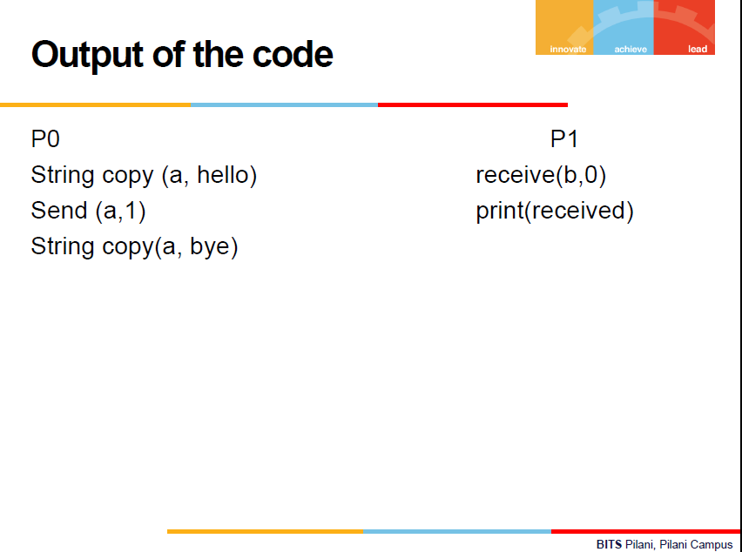

Slide 23
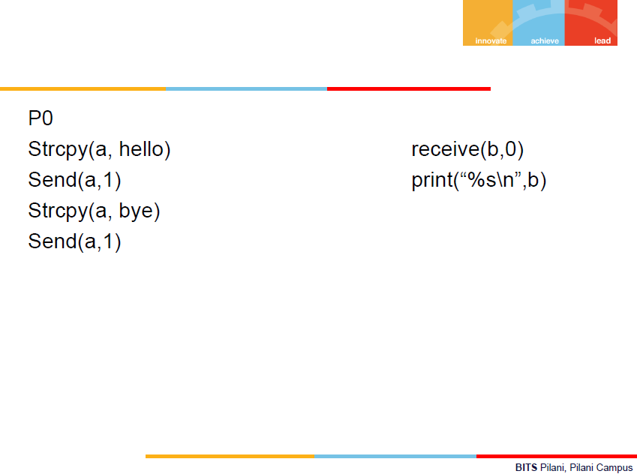

Slide 24
Synchronous Message Passing
Suppose task A and task B are both in execution, and A wishes to send a message to B. If B is busy, it is not desirable to allow another task to interrupt it.
Instead, B can specify to other tasks when it is ready to receive messages. At this point, Task A can send a message. When actual transmission takes place, we refer to a rendezvous.
Cooperation and Competition Synchronization can both be implemented using message passing.
Pilani Campus

Slide 25
Concurrency in Java: Threads
The concurrent units in Java are methods called run whose code can be in concurrent execution with other such methods (of other objects) and with the main method.
The process in which the run method executes is called a thread.
Java’s threads are lightweight tasks which means that they all run in the same address space.
To define a class with a run method,
one can define a subclass of the predefined class Thread and override its run method.
Pilani Campus

Slide 26
The Thread Class
The bare essential of Thread are two methods named run and start. The code of the run method describes the actions of the thread. The start method starts its thread as a concurrent unit by calling its run method.
When a program has multiple threads, a scheduler must determine which thread or threads will run at any given time.
The Thread class provides several method for controlling the execution of threads:
  yield: request from a running thread to surrender the processor
  sleep: blocks a thread for a requested number of milliseconds
  join: forces a method to delay its execution until the run of another thread has completed its execution
  interrupt: sends a message to a thread, telling it to terminate.
Pilani Campus

Slide 27
Priority of Threads
Various Threads can have different priorities.
A thread’s default priority is the same as the thread that created it.
The priority of a thread can be changed with the method setPriority. getPriority returns the current priority of a thread.
When there are threads with different priorities, the scheduler’s behaviour is controlled by these priorities. A thread with lower priority will run only if one of higher priority is not in the task-ready queue when the opportunity arises.
Pilani Campus

Slide 28
Competition Synchronization in Java I
In Java, competition synchronization is implemented by specifying that the methods that access shared data are run completely before another method is executed on the same object.
This is done by adding the synchronized modifier to the method’s definition.
Class ManageBuf{
    Private int [100] buf;
    …
    Public synchronized void deposit (int item) {… }
    Public synchronized void fetch (int item) {… }
    …
  }
An object whose methods are all synchronized is effectively a monitor.
Pilani Campus

Slide 29
Cooperation Synchronization in Java
Cooperation Synchronization in Java uses three methods defined in Object, the root class of all Java classes. These are:
  wait(): every object has a wait list of all the threads that have called wait on the object.
  notify(): notify is called to tell one waiting thread that what it was waiting for has happened.
  notifyall(): notifyall awakens all the threads on the object’s wait list, starting their execution just after their call to wait. It is often used in place of notify.
These three methods can only be called from within a synchronized method because they use the lock placed on an object by such a method.
Pilani Campus

Slide 30
Evaluation of Java’s support for Concurrency
Java’s support for concurrency is relatively simple but effective.
However, Java’s lightweight threads do not allow tasks to be distributed to different processors with different memories, which could be on different computers in different places.
This is where Ada’s more complicated implementation of concurrency has advantages over Java’s.
Pilani Campus

